Slide 1


Slide 2
Directive Principles of State Policy of India

Slide 3
Professor & Lawyer
Puttu Guru Prasad
B.Com., M.Com., M.Phil., M.B.A., PGDFTM., AP.SET., M.Phil., DRMS., L.L.B., ICFAI TMF., DIRM., L.L.M., Pre PhD (PhD)from JNTUK., Topper Domain Topper & 30th Batch Topper at ICFAI -2009 Training for Management Faculty
“Diploma in Psychology from YALE University”
MHRDI’s 'Institution's Innovation Council (IICs)Ambassador
NSS Certified Program Officer, (A.U) ICFAI UNIVERSITY Trained Senior Faculty
Senior Faculty for Business Studies, Economics, Accounts
Head, Board of Administration & Management Science,
BHAGAVAD GITA & CLAT & IPMAT Program Coordinator,
Commerce Department, VIVA-VVIT, Nambur,
My Blog: puttuguru.blogspot.in
My Web Site: https://gurublogs.wixsite.com/guru
93 94 96 98 98, 9885 96 36 36, 807 444 9539,

Slide 4
The Directive Principles of State Policy of India are the guidelines or 15 principles given to the federal institutes governing the State of India, to be kept in citation while framing laws and policies.
These provisions, contained in Part IV of the Constitution of India, are not enforceable by any court, but the principles laid down therein are considered in the governance of the country, making it the duty of the State to apply these principles in making laws to establish a just society in the country.
The principles have been inspired by the Directive Principles given in the Constitution of Ireland which are related to social justice, economic welfare, foreign policy, and legal and administrative matters.

Slide 5
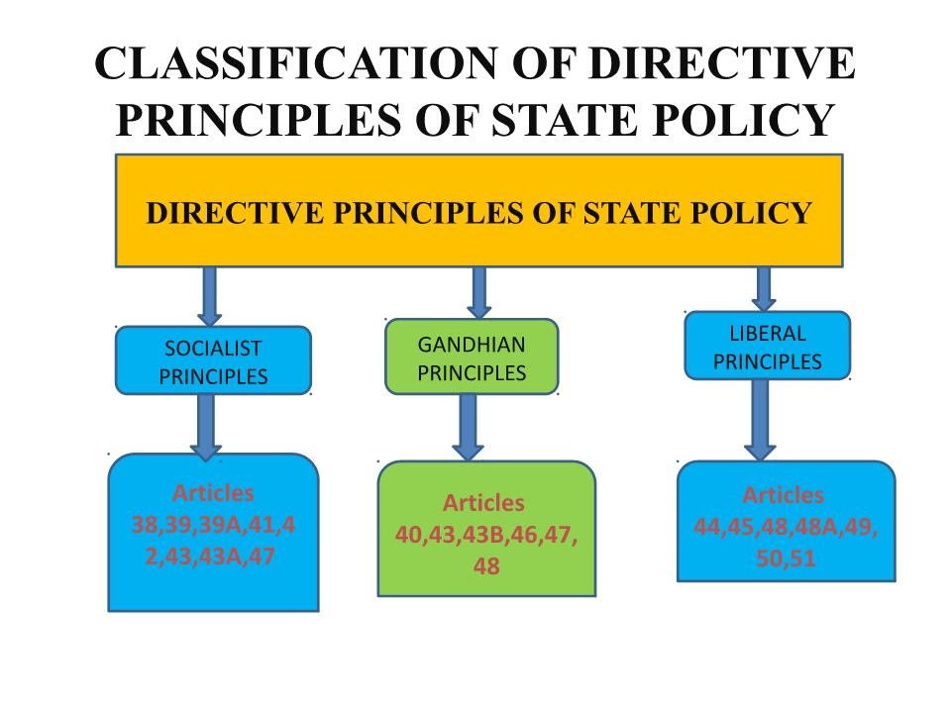

Slide 6
Socialistic Principles
These types of Directive principles of State Policy reflect the ideology of socialism
They aim at providing social and economic justice, and set the path towards welfare state.
Article 38 promote the welfare of the people by
Securing a social order by justice- social, economic and political
Minimizing inequalities in income, status, facilities and opportunities

Slide 7
Socialistic Principles
Article 39 secure
Adequate means of livelihood for all citizen
Equitable distribution of resources for the common good
Prevention of concentration of wealth and means of production
Equal pay for equal work
Preservation of the health and strength of workers and children against forcible abuse

Slide 8
Socialistic Principles
Article 39A
The State shall provide free legal aid to ensure that equal opportunities for securing justice is ensured to all, and is not denied by reason of economic or other disabilities.
Article 41
The State shall endeavour to provide the right to work, to education and to public assistance in cases of unemployment, old age, sickness and disablement, within the limits of economic capacity.
Article 42
The State shall provide for just and humane conditions of work and maternity relief.

Slide 9
Socialistic Principles
Article 43
The State should also ensure living wage and proper working conditions for workers, with full enjoyment of leisure and social and cultural activities. Also, the promotion of cottage industries in rural areas is one of the obligations of the State.
Article 43A
The State shall take steps to promote their participation in management of industrial undertakings.

Slide 10
Socialistic Principles
Article 47
The directive principles commit the State to raise the level of nutrition and the standard of living and to improve public health, particularly by prohibiting intoxicating drinks and drugs injurious to health except for medicinal purposes.

Slide 11
Gandhian Principles
Definition: These principles are based on Gandhian ideology used to represent the programme of reconstruction enunciated by Gandhi during the national movement. Under various articles, they direct the state to:

Slide 12
Gandhian Principles
Article 40
Organise village panchayats and endow them with necessary powers and authority to enable them to function as units of self-government
Article 43
Promote cottage industries on an individual or co-operation basis in rural areas

Slide 13
Gandhian Principles
Article 43B
Promote voluntary formation, autonomous functioning, democratic control and professional management of co-operative societies
Article 46
Promote the educational and economic interests of SCs, STs, and other weaker sections of the society and to protect them from social injustice and exploitation

Slide 14
Gandhian Principles
Article 47
Prohibit the consumption of intoxicating drinks and drugs which are injurious to health
Article 48
Prohibit the slaughter of cows, calves and other milch and draught cattle and to improve their breeds

Slide 15
Liberal-Intellectual Principles
These principles reflect the ideology of liberalism. Under various articles, they direct the state to:
Article 44
Secure for all citizens a uniform civil code throughout the country

Slide 16
Liberal-Intellectual Principles
Article 45
Provide early childhood care and education for all children until they complete the age of six years.
Article 48
Organise agriculture and animal husbandry on modern and scientific lines

Slide 17
Liberal-Intellectual Principles
Article 48A
To protect and improve the environment and to safeguard forests and wildlife
Article 49
Protect monuments, places and objects of artistic or historic interest which are declared to be of national importance

Slide 18
Liberal-Intellectual Principles
Article 50
Separate the judiciary from the executive in the public services of the State
Article 51
Promote international peace and security and maintain just and honourable relations between nations
Foster respect for international law and treaty obligations
Encourage settlement of international disputes by arbitration

